Slide 1
Talent Development
At HCL

Slide 2
TestNG

Slide 3
What is TestNG
TestNG is a testing framework.
It is designed to simplify broad range of testing needs, from Unit Testing (testing a class in isolation of others) to integration testing (testing entire systems made of several classes, several packages and even several external frameworks, such as application servers).
NG stands for Next Generation
It is widely used with Selenium (when compared to other Frameworks like JUnit)
It provides excellent feature of integration with various tools like Maven, Jenkins etc

Slide 4
TestNG - Advantage
It controls the test execution using Test Annotations.
Test Annotations are very simple and easy to use.
It can group test cases.
It can setup priority for test execution.
It facilitates parallel testing.
It generate Test Execution Report.
It supports Parameterization.

Slide 5
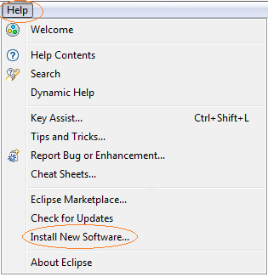
Installation
Launch Eclipse
On the Menu bar, click “Help”.
Choose “Install New Software” option.

Slide 6
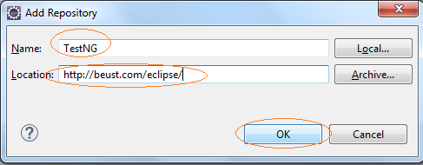
Installation
In the Install dialog box, click the “Add” button.
In the name, type “TestNG”.
In Location, enter “http://beust.com/eclipse/”
Select “Ok”

Slide 7
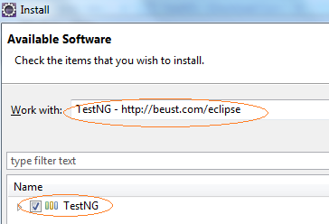
Installation
"TestNG - http://beust.com/eclipse" should be populated onto the "Work with:" textbox.
Check the "TestNG" check box as shown below, then click Next
Click no the “Next” button.
Accept the Terms and Conditions.

Slide 8
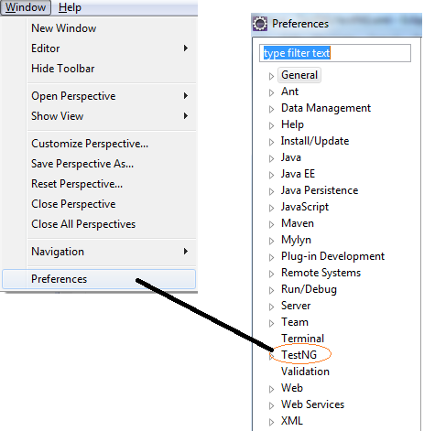
Installation
Wait till the installation is complete.
Restart Eclipse when prompted.
After Restart, click on Windows -> Preference to check if the installation is successful. You should be able to see TestNG option under Windows -> Preference.

Slide 9
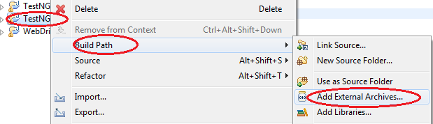
TestNG Project Creation in Eclipse
Launch Eclipse
Click File -> New -> Java Project
Enter a Project name. Let’s use “MyTestNGProject”
Click on “Next” and “Finish”.
Right Click on the project -> Build Path -> Add External Archive -> Import all Selenium jar files.

Slide 10
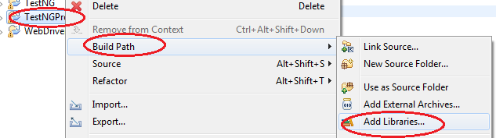
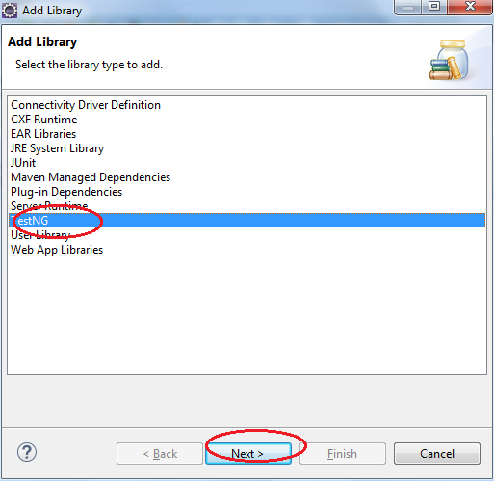
TestNG Project Creation in Eclipse
Right Click on the project -> Build Path -> Select Add Library
Select “TestNG” from the Add Library list and click Next and Finish

Slide 11

TestNG Project Creation in Eclipse
Once done, the project should be visible as given below in Eclipse Package Viewer Window.

Slide 12
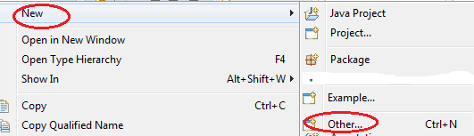
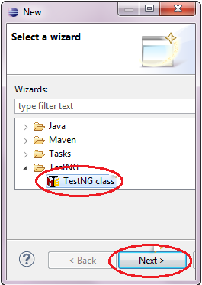
Creating a new TestNG Test file
Right click on the “src” folder.
Select New -> Others…
Select “TestNG Class” -> Next

Slide 13
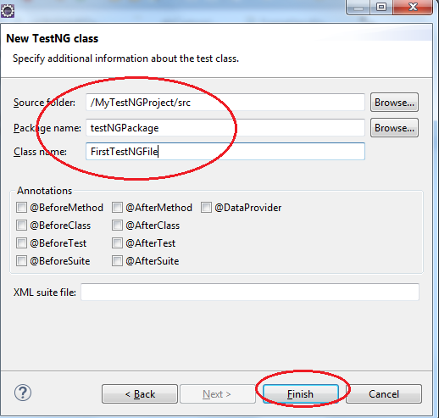
Creating a new TestNG Test file
Enter the value as indicated and select “Finish”

Slide 14
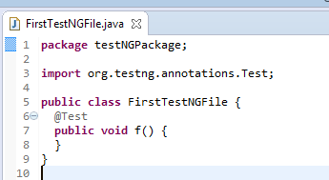
Creating a new TestNG Test file
Eclipse should automatically create the template for the TestNG file.

Slide 15
Developing first Test Case
Let’s create a sample test case to check if myHCL home page is correct or not.
package testNGPackage;
import org.openqa.selenium.WebDriver;
import org.openqa.selenium.firefox.FirefoxDriver;
import org.testng.Assert;
import org.testng.annotations.Test;
public class FirstTestNGFile {
public String baseUrl = "https://www.myhcl.com/Login/home.aspx";
public WebDriver myhcl_WD = new FirefoxDriver();
@Test
public void verifyHomepageTitle() {
myhcl_WD.get(baseUrl);
String expectedTitle = "My HCL Login";
String actualTitle = myhcl_WD.getTitle();
Assert.assertEquals(actualTitle, expectedTitle);
myhcl_WD.quit();
}
}

Slide 16

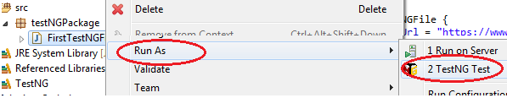
Developing first Test Case
Let’s run it. We will see the annotation later on.
To run the test, run the file in eclipse normally (either you can select Run option or right click the file and select Run As -> TestNG Test)

Slide 17
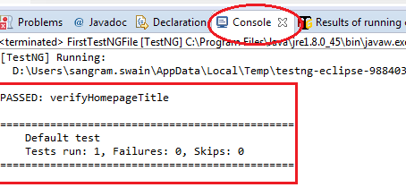
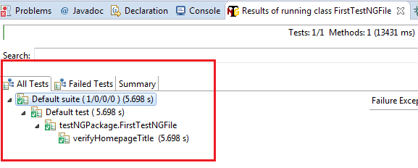
Checking the execution result
Eclipse will provide two outputs – one in Console Window and the other on TestNG result window
Console Window
Test Result Window

Slide 18
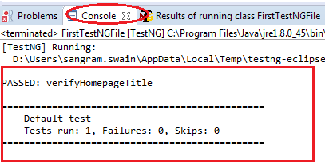
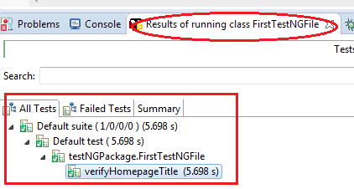
Checking reports created by TestNG
Console Window gives a text-based report while TestNG result window give us a graphical one.
Console Window
Test Result Window

Slide 19

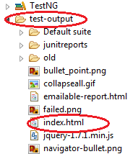
Generating HTML Report
After running “FirstTestNGFile”, right click on the Project name “MyTestNGProject” and select “Refresh”
A folder having name “test-output” will be created.

Slide 20
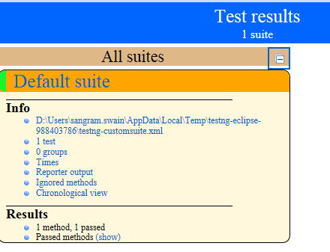
Generating HTML Report
Open the index.html file with Eclipse’s build-in Web Browser

Slide 21
TestNG - Annotation
Annotation | Description
@BeforeSuite | The annotated method will be run only once before all tests in this suite have run.
@AfterSuite | The annotated method will be run only once after all tests in this suite have run.
@BeforeClass | The annotated method will be run only once before the first test method in the current class is invoked.
@AfterClass | The annotated method will be run only once after all the test methods in the current class have run.
@BeforeTest | The annotated method will be run before any test method belonging to the classes inside the <test> tag is run.
@AfterTest | The annotated method will be run after all the test methods belonging to the classes inside the <test> tag have run.
@BeforeGroups | The list of groups that this configuration method will run before. This method is guaranteed to run shortly before the first test method that belongs to any of these groups is invoked.
@AfterGroups | The list of groups that this configuration method will run after. This method is guaranteed to run shortly after the last test method that belongs to any of these groups is invoked.

Slide 22
TestNG - Annotation
Annotation | Description
@BeforeMethod | The annotated method will be run before each test method.
@AfterMethod | The annotated method will be run after each test method.
@DataProvider | Marks a method as supplying data for a test method. The annotated method must return an Object[ ][ ], where each Object[ ] can be assigned the parameter list of the test method. The @Test method that wants to receive data from this DataProvider needs to use a dataProvider name equals to the name of this annotation.
@Parameters | Describes how to pass parameters to a @Test method.
@Test | Marks a class or a method as a part of the test.
@Listeners | Defines listeners on a test class.
@Factory | Marks a method as a factory that returns objects that will be used by TestNG as Test classes. The method must return Object[ ].

Slide 23
@Test
@Test indicates that the method followed by it is a Test Case.
We can use as many as @Test annotation in a TestNG file.
By default, methods annotated by @Test are executed alphabetically.

Slide 24
@Test - Code
package testNGPackage;
import org.testng.annotations.Test;
public class testAnnotationDemo {
@Test
public void firstMehod() {
System.out.println("This is the first method.");
}
@Test
public void secondMethod(){
System.out.println("This is the second method.");
}
@Test
public void thirdMethod(){
System.out.println("This is the third method.");
}
@Test
public void fourthMethod(){
System.out.println("This is the fourth method");
}
}

Slide 25
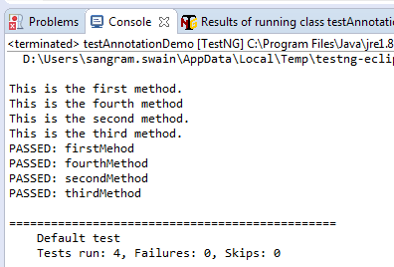
Execution Result
As mentioned earlier, there are 4 test cases and the execution will take place alphabetically.
fourthMethod() will be executed before secondMethod()

Slide 26
TestNG Parameter - Priority
Parameters basically controls the execution order in TestNG.
Parameters are keywords that modifies the annotation’s function.
User need to assign value to parameter which will decide the execution order.
Priority: As mentioned earlier, TestNG test case execution takes place in alphabetical order. The execution flow can be changes using “Priority” parameter.
Lowest priority test case will be executed first.
Highest priority test case will be executed last.
Priority values need not be consecutive.

Slide 27
Parameter – ‘Priority’ - Code
package testNGPackage;
import org.testng.annotations.Test;
public class priorityParameter {
@Test(priority = 3)
public void firstMehod() {
System.out.println("This is the first method.");
}
@Test (priority = 0) // Lowest priority, so will be executed first
public void secondMethod(){
System.out.println("This is the second method.");
}
@Test (priority = 6)
public void thirdMethod(){
System.out.println("This is the third method.");
}
@Test (priority = 8) // highest priority, so will be executed last.
public void fourthMethod(){
System.out.println("This is the fourth method");
}
}

Slide 28
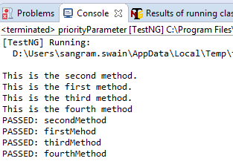
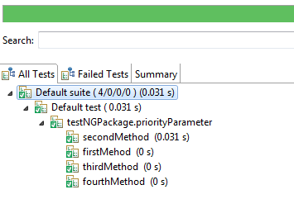
Parameter – ‘Priority’ - Execution

Slide 29
@BeforeTest - @AfterTest
@BeforeTest – methods under this annotation will be executed prior to the first test case in the TestNG file
@AfterTest - methods under this annotation will be executed after all test cases in the TestNG file are executed.
Let’s look at the following example
While coding, you do not need to maintain any sequence of these annotation. TestNG will automatically take care of it.

Slide 30
@BeforeTest - @AfterTest - Code
package testNGPackage;
import org.openqa.selenium.WebDriver;
import org.openqa.selenium.firefox.FirefoxDriver;
import org.testng.Assert;
import org.testng.annotations.Test;
import org.testng.annotations.BeforeTest;
import org.testng.annotations.AfterTest;
public class MyHCLTitleCheck {
public String baseURL = "https://www.myhcl.com/Login/home.aspx";
public WebDriver myhcl_WD = new FirefoxDriver();
@BeforeTest // Will be executed before the test case
public void launchBrowser() {
System.out.println("Executed before the test case");
myhcl_WD.get(baseURL);
}
@Test
public void verifyHomepageTitle() {
String expectedTitle = "My HCL Login";
String actualTitle = myhcl_WD.getTitle();
Assert.assertEquals(actualTitle, expectedTitle);
}
@AfterTest //will be executed after the test case
public void terminateBrowser() {
System.out.println("Executed after the test case");
myhcl_WD.quit();
}
}

Slide 31
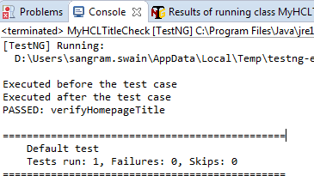
Execution Result
The sequence of execution will be
launchBrowser()
verifyHomepageTitle()
terminateBrowser
The output will be

Slide 32
@BeforeMethod - @AfterMethod
@BeforeMethod – methods under this annotation will be executed prior to each method in each test case
@AfterMethod - methods under this annotation will be executed after each method in each test case.
Let’s look at the following example
While coding, you do not need to maintain any sequence of these annotation. TestNG will automatically take care of it.

Slide 33
@BeforeMethod - @AfterMethod - Code
The code as given below will do –
Go to the URL - http://newtours.demoaut.com/
Will verify the title of the homepage
Click REGISTER link and will verify the title of the page
Go back to the homepage and will check the title.
Click SUPPORT and check the title
Go to the homepage again and check the title again

Slide 34
@BeforeMethod - @AfterMethod - Code
package testNGPackage;
import org.openqa.selenium.By;
import org.openqa.selenium.WebDriver;
import org.openqa.selenium.firefox.FirefoxDriver;
import org.testng.Assert;
import org.testng.annotations.Test;
import org.testng.annotations.BeforeMethod;
import org.testng.annotations.AfterMethod;
import org.testng.annotations.BeforeTest;
import org.testng.annotations.AfterTest;
public class before_afterMethod {
public String baseUrl = "http://newtours.demoaut.com/";
public String actual = null;
public String expected = null;
public WebDriver driver = new FirefoxDriver();
@BeforeTest // will be executed first
public void launchBrowser() {
driver.get(baseUrl);
}
@BeforeMethod // will be executed before executing any method
public void verifyHomePageTitle() {
expected = "Welcome: Mercury Tours";
actual = driver.getTitle();
Assert.assertEquals(actual, expected);
}

Slide 35
@BeforeMethod - @AfterMethod - Code
@Test(priority = 0) // First Test Case to check the home page title
public void register() {
driver.findElement(By.linkText("REGISTER")).click();
expected = "Register: Mercury Tours";
actual = driver.getTitle();
Assert.assertEquals(actual, expected);
}
@Test(priority = 1) // Second Test Case to check the title of Support page
public void support(){
driver.findElement(By.linkText("SUPPORT")).click();
expected = "Under Construction: Mercury Tours";
actual = driver.getTitle();
Assert.assertEquals(actual, expected);
}
@AfterMethod // will be executed after every test case
public void goBackToHomePage() {
driver.findElement(By.linkText("Home")).click();
}
@AfterTest // will be executed finally after completion of all test cases
public void terminateBrowser() {
driver.quit();
}
}

Slide 36
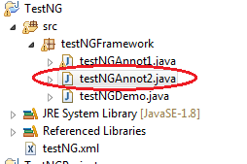
@BeforeSuite - @AfterSuite
@BeforeSuite – The annotated method will be run before all tests in this suite have run.
@AfterSuite - The annotated method will be run after all tests in this suite have run.
Let’s check the following code.
We have the @BeforeSuite and @AfterSuite in the file - testNGAnnot2

Slide 37
Code – testNGAnnot1.java
package testNGFramework;
import org.testng.annotations.AfterMethod;
import org.testng.annotations.AfterTest;
import org.testng.annotations.BeforeMethod;
import org.testng.annotations.BeforeTest;
import org.testng.annotations.Test;
import org.testng.annotations.BeforeSuite;
import org.testng.annotations.AfterSuite;
public class testNGAnnot1 {
@BeforeMethod
public void beforeM(){
System.out.println("testNGAnnot1-----Before Method----");
}
@AfterMethod
public void afterM(){
System.out.println("testNGAnnot1-----After method-----");
}
@BeforeTest
public void beforeT(){
System.out.println("testNGAnnot1----Before Test-----");
}
@AfterTest
public void afterT(){
System.out.println("testNGAnnot1----After Test-----");
}
@Test
public void openBrowser() {
System.out.println("testNGAnnot1----This is a test case---Opening browser");
}
@Test
public void closeBrowser(){
System.out.println("testNGAnnot1----This is a test case ----- Closing browser");
}
}

Slide 38
Code – testNGAnnot2.java
package testNGFramework;
import org.testng.annotations.Test;
import org.testng.annotations.BeforeSuite;
import org.testng.annotations.AfterSuite;
public class testNGAnnot2 {
@BeforeSuite
public void beforeSuite() {
System.out.println("-----Before Suite-----");
}
@Test
public void doThis(){
System.out.println("testNGAnnot2---This is a test case");
}
@AfterSuite
public void afterSuite() {
System.out.println("-----After suite-----");
}
}

Slide 39
Code – testNGDemo.java
package testNGFramework;
import org.testng.annotations.AfterMethod;
import org.testng.annotations.BeforeMethod;
import org.testng.annotations.Test;
import org.testng.annotations.BeforeTest;
import org.testng.annotations.AfterTest;
public class testNGDemo {
@BeforeMethod
void beforeExecution(){
System.out.println("testNGDemo-------Before Method-------");
}
@AfterMethod
void afterExecution(){
System.out.println("testNGDemo--------After Method-------------------");
}
@Test
public void firstMethod() {
System.out.println("testNGDemo- This is the first method");
}
@Test
public void secondMethod() {
System.out.println("testNGDemo - This is the second method");
}
@BeforeTest
public void beforeTest() {
System.out.println("testNGDemo--------BEFORE TEST--------");
}
@AfterTest
public void afterTest() {
System.out.println("testNGDemo--------AFTER TEST--------");
}
}

Slide 40
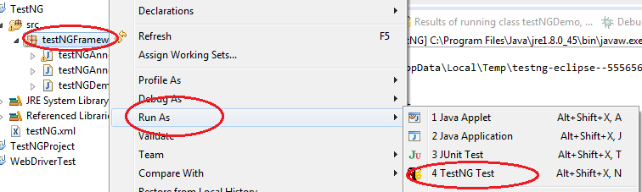
Running the code
Right click on the package and select Run As -> TestNG Test

Slide 41
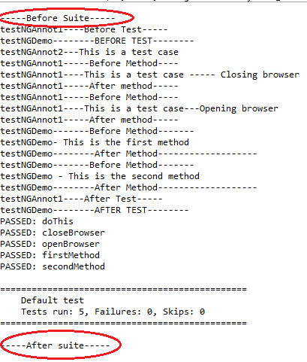
Output
The output will look like

Slide 42
Parameter - enabled
enabled parameter is used to exclude the execution of any test if user wants.
The syntax is
@Test(enabled = false)
In the following code, we do not want to exclude the following test cases during execution.
secondTestCase()
thirdTestCase()

Slide 43
Parameter – enabled - Code
package testNGPackage;
import org.testng.annotations.Test;
public class enableDemo {
@Test
public void fistTestCase() {
System.out.println("This is the first test case");
}
@Test(enabled = false)
public void secondTestCase() {
System.out.println("This is the second test case");
}
@Test(enabled = false)
public void thirdTestCase() {
System.out.println("This is the third test case");
}
@Test
public void fourthTestCase() {
System.out.println("This is the fourth test case");
}
}

Slide 44
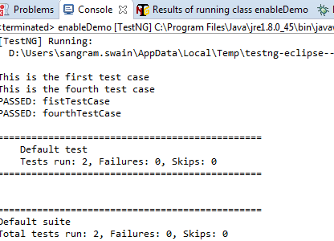
Parameter – enabled - output
It will execute fistTestCase() and fourthTestCase()
secondTestCase() and thirdTestCase() will be excluded.

Slide 45
TestNG - XML
TestNG XML file is an XML file that describes the runtime definition of a test suite.
It describes complex test definition while still remaining easy to edit.
Using Testng.xml file user can run test available in one or more class file and make them as a single group, hence making test more meaningful, we call them as scenario based testing.
It can group classes and packages as well.
This is basically a configuration file which decides the execution pattern depending on what all attributes it has.
This is more of a Test Case Execution Management tool.

Slide 46
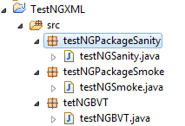
TestNG - XML
Let’s consider the following Project – TestNGXML. It has 3 different test suites
Sanity
Smoke
BVT.
We will only execute the Sanity Test Cases which are under the class having name – testNGSanity under package – testNGPackageSanity

Slide 47
TestNG - XML
Code of testNGSanity class under package – testNGPackageSanity
package testNGPackageSanity;
import org.testng.annotations.Test;
import org.testng.annotations.BeforeMethod;
import org.testng.annotations.AfterMethod;
public class testNGSanity {
@Test
public void sanityTestcase1() {
System.out.println("This is Sanity Test Case1");
}
@Test
public void sanityTestcase2(){
System.out.println("This is Sanity Test Case2");
}
@BeforeMethod
public void beforeMethod() {
System.out.println("Start - Executing Sanity Package");
}
@AfterMethod
public void afterMethod() {
System.out.println("Finish - Executing Sanity Package");
}
}

Slide 48
TestNG - XML
The project has 2 other packages having different classes under those.
<package> testNGPackageSmoke -> <class> testNGSmoke
<package> tetNGBVT -> <class>testNGBVT
But we want to exclude these 2 packages during execution.
Only Sanity Test cases under package – testNGPackageSanity will be executed.
For that let’s create a XML file.

Slide 49

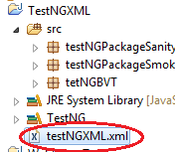
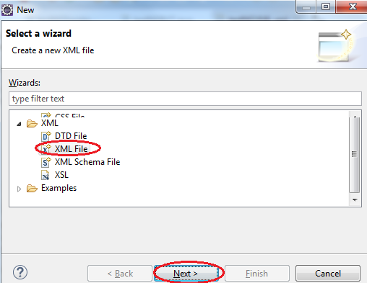
TestNG - XML
Right Click on the Project Name “TestNGXML” -> Select “New” -> Select “Other…”
Scroll down from the “Select a wizard” option and select “XML File” and click “Next”.
Give the name as “testNGXML” and click Finish.

Slide 50
TestNG - XML
Edit the XML file and put the following code.
<?xml version="1.0" encoding="UTF-8"?>
<suite name = "Sanity Testing">
<test name = "Sanity TestCases">
<classes>
<class name = "testNGPackageSanity.testNGSanity"/>
</classes>
</test>
</suite>
Explanation
Use <suite> and </suite> to define the test suite – give any name
Use <test> and </test> to define the test – give any name
Use <classes> and </classes> to define the class name
Class name should be fully qualified - packagename.classname

Slide 51
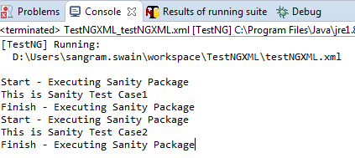
TestNG - XML
Let’s execute it.
To execute -> Right Click on the XML file -> Select “Run As” -> TestNGSuites
The result will look like. Only class – testNGSanity under package testNGPackageSanity will be executed

Slide 52
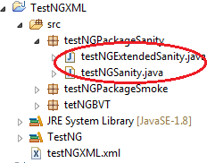
More than 1 class in the same package
Now let’s see how to execute more than 1 class under the same package.
As given below, now we have 2 classes under the same package testNGPackageSanity
testNGExtendedSanity
testNGSanity
To execute these 2 classes, all we have to do
is to modify the XML file only.

Slide 53
More than 1 class in the same package
Now let’s see how to execute more than 1 class under the same package.
As given below, now we have 2 classes under the same package testNGPackageSanity
testNGExtendedSanity
testNGSanity
To execute these 2 classes, all we have to do
is to modify the XML file only.

Slide 54
More than 1 class in the same package
Now the XML file will look like
<?xml version="1.0" encoding="UTF-8"?>
<suite name = "Sanity Testing">
<test name = "Sanity TestCases">
<classes>
<class name = "testNGPackageSanity.testNGSanity"/>
<class name = "testNGPackageSanity.testNGExtendedSanity"/>
</classes>
</test>
</suite>
You can include as many class as possible in the same way.

Slide 55
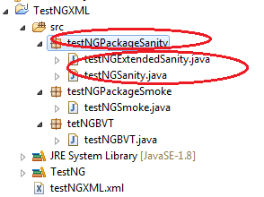
Running classes in package level
Now let’s see how can we run all or selected classes in a package level.
Let’s write a XML file which will run all the classes under the package – testNGPackageSanity

Slide 56
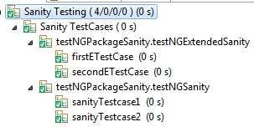
Running classes in package level
The XML file will look like
<?xml version="1.0" encoding="UTF-8"?>
<suite name = "Sanity Testing">
<test name = "Sanity TestCases">
<packages>
<package name = "testNGPackageSanity"/>
</packages>
</test>
</suite>
It will execute both the classes testNGExtendedSanity and testNGSanity under the package testNGPackageSanity

Slide 57
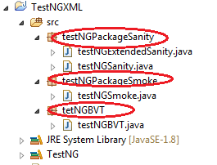
Running multiple packages
If a project has multiple packages and user wants to run all packages, the XML files should look like this.
<?xml version="1.0" encoding="UTF-8"?>
<suite name = "Sanity Testing">
<test name = "Sanity TestCases">
<packages>
<package name = "testNGPackageSanity"/>
<package name = "testNGPackageSmoke"/>
<package name = "tetNGBVT"/>
</packages>
</test>
</suite>
This will execute all classes under all the packages

Slide 58
Data Driven Framework
Let’s write a data driver framework using TestNG. (Refer to code - TestND_DataDriverFW)
Data Driven framework is the one where the test cases are supplied with data from the script itself.
We will use 2 annotation
@DataProvider: This annotation is used to define the number of times the test cases is executed and the number of parameter/ data which will be supplied to the method (test case)
dataProvider: This annotation is used with @Test annotation to indicate that the test case/ method will take the parameter from the method where we have used the annotation @DataProvider

Slide 59
Data Driven Framework
@DataProvider
We have to declare a 2 dimensional array
Let us consider a method that will supply the user credentials for logging into myHCL.
The code will typically look like
@DataProvider
public Object[][] getData(){
Object[][] myHCLCredentials = new Object[1][3];
myHCLCredentials[0][0] = “User ID";
myHCLCredentials[0][1] = “Password";
myHCLCredentials[0][2] = "HCLTECH";
return myHCLCredentials;
}

Slide 60
Code Analysis
As the method getData() will act as the Data Provider, so we have to use the annotation @DataProvider before this method
We have to declare a 2 dimensional array
Object[][] myHCLCredentials = new Object[i][j];
Here i stands for the number of times the test case should run
j stands for the number of parameters which should be send in one go.
Then we have to assign value to each array element.

Slide 61
Code Analysis
As the receiving end, we need to use the annotation dataProvider annotation before the method where we will receive those data.
The code will typically look like
@Test (dataProvider = "getData")
public void supplyCredentials(String userName, String passWord, String domain) {
myhcl_WD.findElement(By.xpath(".//*[@id='txtUserID']")).sendKeys(userName);
myhcl_WD.findElement(By.xpath(".//*[@id='txtPassword']")).sendKeys(passWord);
myhcl_WD.findElement(By.xpath(".//*[@id='ddlDomain']")).sendKeys(domain);
myhcl_WD.findElement(By.xpath(".//*[@id='btnSubmit']")).click();
}
getData is the name of the method from where we are supplying the data which is annotated with dataProvider annotation.

Slide 62
Code
The code looks like
package dataDriverFW;
import org.openqa.selenium.By;
import org.openqa.selenium.WebDriver;
import org.openqa.selenium.firefox.FirefoxDriver;
import org.testng.annotations.DataProvider;
import org.testng.annotations.Test;
import org.testng.annotations.BeforeMethod;
import org.testng.annotations.AfterMethod;
public class dataDrivenFWTC {
public String baseURL = "https://www.myhcl.com/";
public WebDriver myhcl_WD= new FirefoxDriver();
@Test (dataProvider = "getData")
public void supplyCredentials(String userName, String passWord, String domain) {
myhcl_WD.findElement(By.xpath(".//*[@id='txtUserID']")).sendKeys(userName);
myhcl_WD.findElement(By.xpath(".//*[@id='txtPassword']")).sendKeys(passWord);
myhcl_WD.findElement(By.xpath(".//*[@id='ddlDomain']")).sendKeys(domain);
myhcl_WD.findElement(By.xpath(".//*[@id='btnSubmit']")).click();
}

Slide 63
Code
@BeforeMethod
public void initializeDriver() {
myhcl_WD.get(baseURL);
}
@AfterMethod
public void afterMethod() {
}
@DataProvider
public Object[][] getData(){
// The test case will be executed once and number of parameter supplied will be 3
Object[][] myHCLCredentials = new Object[1][3];
myHCLCredentials[0][0] = “UserID";
myHCLCredentials[0][1] = “Password";
myHCLCredentials[0][2] = “Domain";
return myHCLCredentials;
}
}

Slide 64
TestNG.XML file Parameterization
Test data can be supplied by parameterizing the TestNG.xml file as well.
Annotation “Parameter” is used for the same in the TestNG.xml file along with the parameter name and value.
Name defined the Parameter/ Test Data name
Value contains the value of the test data.
Use the annotation “@Parameters” in the TestNG class after @Test and before the method where the parameters will be used.
The method in the TestNG class should have the same type and number of Parameter as defined in the XML file.

Slide 65
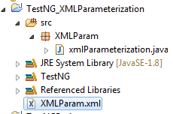
TestNG.XML file Parameterization - Code
Let’s write a xml (XMLParam.xml)file which will pass 2 parameters to a TestNG class “xmlParameterization”.
XML File – Code - TestNGXMLParameterization
<?xml version="1.0" encoding="UTF-8"?>
<suite name="Param Test">
<test name="Parameterization Demo">
<parameter name = "adminUserID" value = "Sangram.Swain"/>
<parameter name = "adminPassword" value = "Password"/>
<classes>
<class name = "XMLParam.xmlParameterization"/>
</classes>
</test>
</suite>

Slide 66
TestNG.XML file Parameterization - Code
Now let’s look at the code for the TestNG class “xmlParameterization”
package XMLParam;
import org.testng.annotations.Parameters;
import org.testng.annotations.Test;
public class xmlParameterization {
@Test
@Parameters ({"adminUserID", "adminPassword"})
public void getCredentials(String userID, String passWord) {
System.out.println(userID);
System.out.println(passWord);
}
}

Slide 67
TestNG.XML file Parameterization - Code
The XML file has “parameter” just before the class declaration.
It has name and value associated with it.
We can pass as many as arguments as we wish. We need to use the “parameter” keyword for it.
Now the TestNG class has the annotation @Parameters after the @Test annotation and before the method which is expecting the parameter.
As we are passing 2 parameters, so we need to declare 2 arguments in the method to catch those values. Any mismatch will cause error.

Slide 68
Global Parameter using Java – Properties class
It is always a good practice to keep all the test data (such as user credentials, URL etc) in a place where it can be accessed globally.
This can be achieved through the following steps
Creating a Property file.
Using Properties class of Java.
Advantage of storing parameters/ test data as global variable
It helps the user not to hard code anything in the source code.
Any change in the test data, user will change the value in the global file and not in every source code file where the data are used.
Use can change the global variables as many times as required depending on the test environment without changing any code.

Slide 69
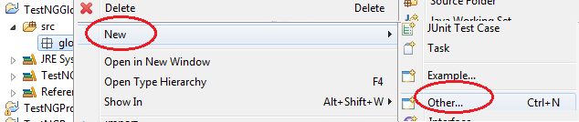
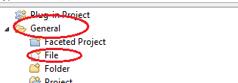
Global Parameter using Java – Creating a Property file
Right click on the Package/ Project
Select New -> Other ->
From the widget, select General ->File
Give the file name with extension “.properties” or any other name
Properties class can interpret the file having extension “.properties”

Slide 70
Global Parameter using Java – Creating a Properties file
Once the properties file is created, put the variable name and value as shown below.
username=Sangram.Swain
password=password
url=https://www.myhcl.com/Login/home.aspx

Slide 71
Global Parameter using Java – Creating TestNG class
Create a TestNG class (Code - TestNGGlobalParamProperties)
Declare an object of Java class – Properties
Use FileInputStream object to link the “.properties” file by giving the path of the properties file (right click the “.properties” file -> Select Properties -> You should see the path of the file under “Location”) -> Copy it and Pass the path as an argument while creating FileInputStream object (Do not forget to change the single “\” to double “\\”)
Use load method of Properties class to establish connection between the TestNG class and the “.properties” file.
Use getProperty() method to get the value of the parameter passed from the .properties file. Use the exact variable name.

Slide 72
Global Parameter using Java – Creating TestNG class
Code of the TestNG class.
package globalParamProperties;
import java.io.FileInputStream;
import java.io.FileNotFoundException;
import java.io.IOException;
import java.util.Properties;
import org.testng.annotations.Test;
public class gParamProp {
@Test
public void login() throws IOException {
Properties prop = new Properties();
FileInputStream fis = new FileInputStream("D:\\Users\\sangram.swain\\workspace\\TestNGGlobalParamProperties\\src\\globalParamProperties\\param.properties");
prop.load(fis);
System.out.println("Username = "+ prop.getProperty("username"));
System.out.println("Password = " + prop.getProperty("password"));
System.out.println("URL = "+ prop.getProperty("url"));
}
}

Slide 73
Global Parameter using Java – Advantage
Let’s consider a practical example now where in we need to execute a set of test cases in different browsers supported by Selenium.
We will test login functionality of MYHCL webpage in different Web Browser (FF, Chrome, IE etc).
All we have to do is define a variable with name browser and define the browser type in the “.properties” file.
We will compare the browser value in the TestNG class and depending on the type of browser, we will write code to invoke the corresponding browser only.
So no need to change the whole code for different browser type. It should be the .properties file which will take care of it.

Slide 74
Global Parameter using Java – .properties file code
The .properties file code is as given below. Depending on which browser to invoke, the value of the browser can be changed.
myHCL_url="https://www.myhcl.com/"
userID="UserID"
password="password"
browser="Firefox“

Slide 75
Global Parameter using Java – TestNG Class code
package propAdvTestNG;
import java.io.FileInputStream;
import java.io.IOException;
import java.util.Properties;
import org.openqa.selenium.WebDriver;
import org.testng.annotations.Test;
public class myHCLDemo {
@Test
public void loginMyHCL() throws IOException {
Properties prop = null;
FileInputStream fis = null;
prop = new Properties();
fis = new FileInputStream("D:\\Users\\sangram.swain\\workspace\\Prop_Advantage_TestNG\\src\\propAdvTestNG\\propAdvTestNG.properties");
prop.load(fis);
if (prop.getProperty("browser").contains("Firefox")){
// Code to invoke Firefox
}
else if ((prop.getProperty("browser")).contains("InternetExplorer")){
// Code to invoke IE
}
else if ((prop.getProperty("browser")).contains("Chrome")){
// Code to invoke Chrome
}
else {
System.out.println("Browser not supported by Selenium");
}
}
}

